Slide 1
新人週報
報告人:林萬郝

Slide 2
T-BAWL介紹

Slide 3
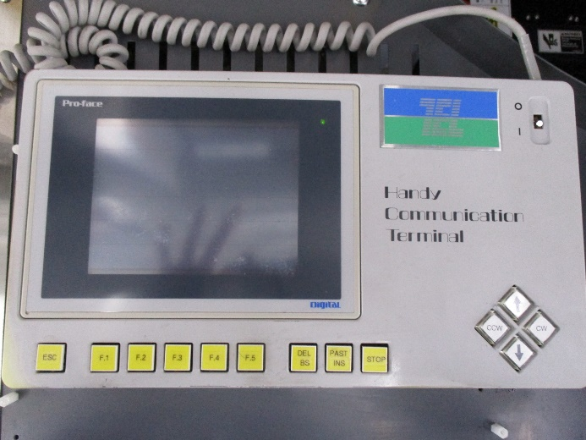
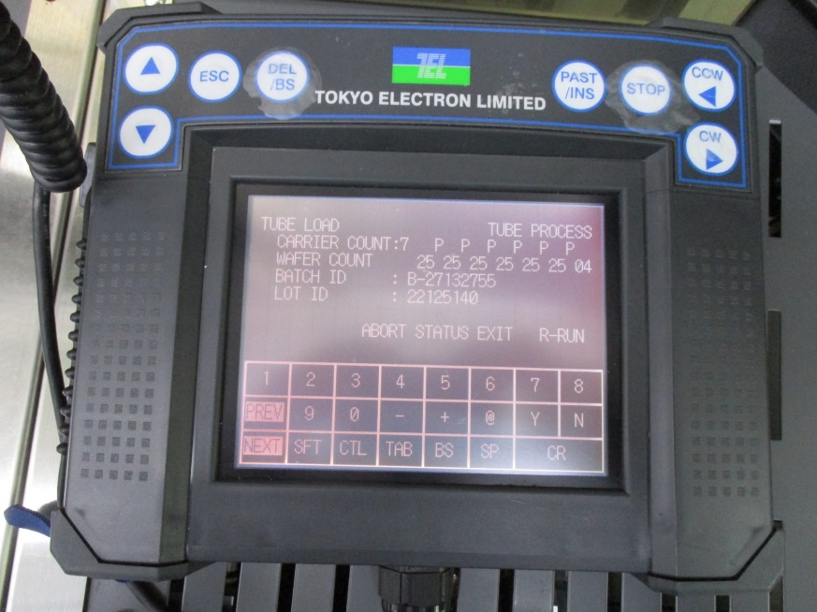
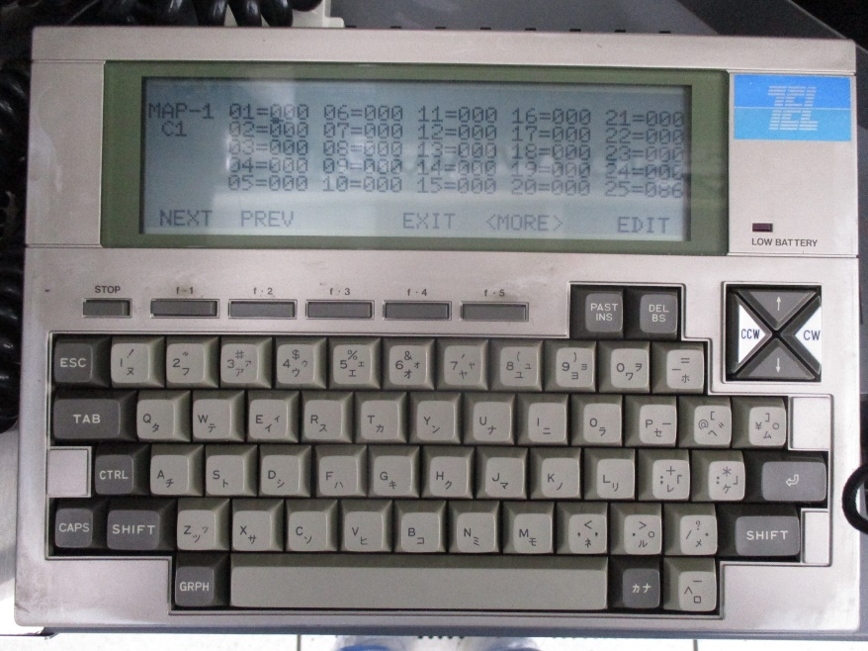
T-BAWL功能
設定一套自動程序 or 手動操作
將CASSETTE傳送至STAGE
將WAFERT傳送至BOAT
Driver
Cassette
Stage
T-BAWL
Wafer
Boat

Slide 4
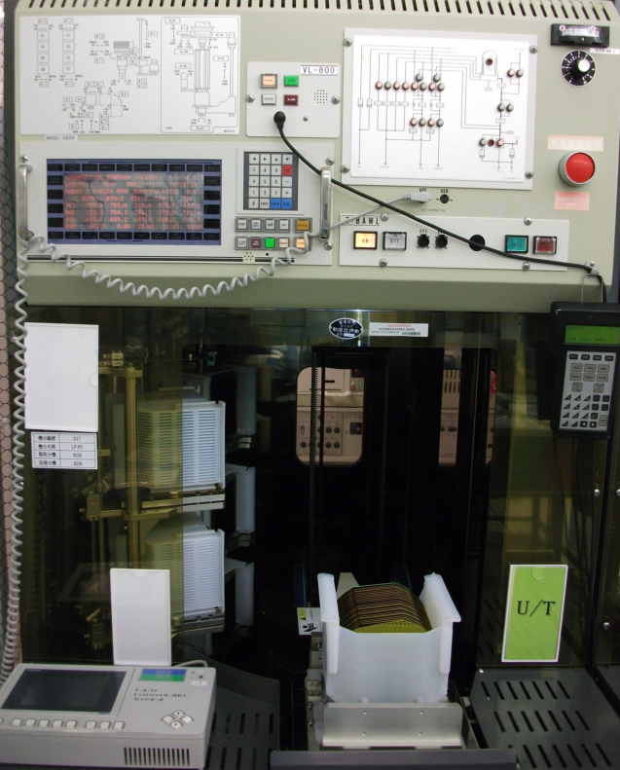
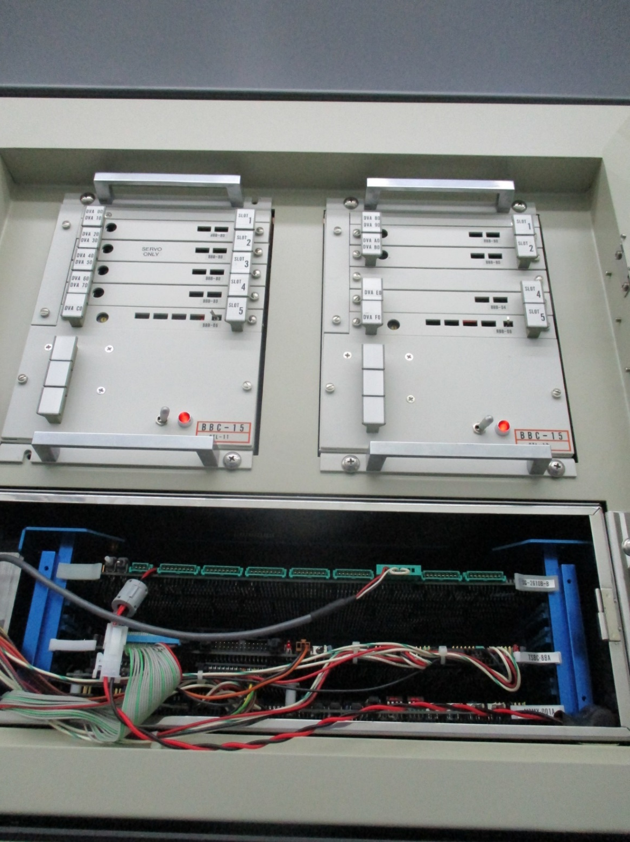
01. 傳送機示意圖
02. 製程氣體 Flow Chart
03. M3100/3200 控制/顯示面板
04. VL-800 控制器
05. T-BAWL 控制器
06. 上/下貨區 Load/Unload
07. Cassette 放置區
01
02
03
04
07
06
05
T-BOWL Contraller

Slide 5
T-BAWL設定介紹
IDLE
INIT
DIAG
EVAL
RUN
EDIT
MDFY
STATUS
TIME
TEST
SYSG

Slide 6
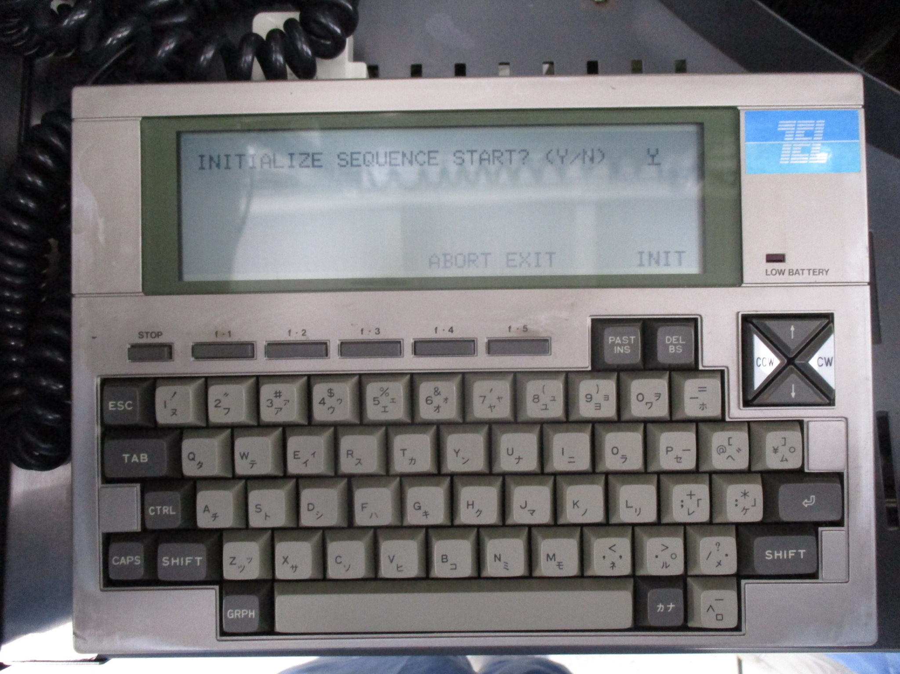
一.INIT MODE
1.Base Position Adjustment
2.Home Position resetting

Slide 7
1.One Motion
各部位單動
2.One Initialize
各部位B.P adjust及H.P Reset initialize
3.Original Motion
調整 Carrier top 及boat top and Btm position
4.WEL Pitch Slide
移動wafer傳送垂直機構為檢查wafer在carrier或Boat位置
5.Sensor Check
各個sensor檢查
6.Alarm Log Counter
查看alarm訊息及alarm次數
DIAG

Slide 8
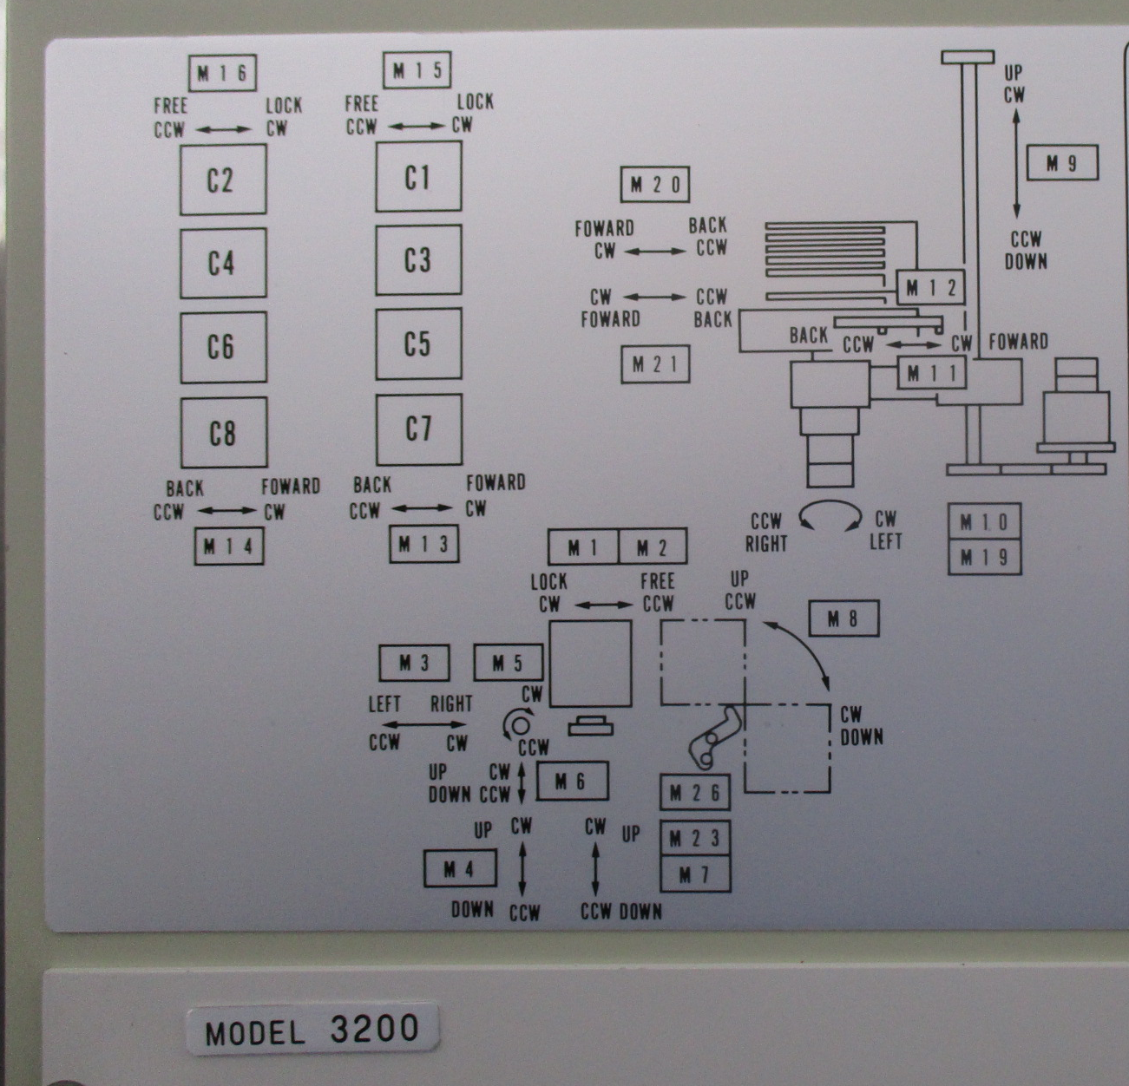
1.ONE MOTION
01 CP1_LU (Carrier port1 lock unlock)
02 CP2_LU (Carrier port2 lock unlock)
03 CPOT_LR (For carrier port left/right)
04 OFAJ_UD (Orientation flat adjust UP DOWN)
05 OFAJ_RT (Orientation flat adjust ROTATE)
06 OFUA_UD (Orientation flat UP ADUJST UP DOWN)
07 WCNT_UD (WAFER COUNT UP DOWN)
08 CPOT_UD (CARRIER PORT UP DOWN)
09 CELV_UD (CARRIER ELEVAOR UP DOWN)
10 CARR_RT (CARRIER ROTATE)
11 CHND_FB (CARRIER HAND FORWARD BACK)
12 CHND_LU (CARRIER HAND LOCK UNLOCK)
13 CSTA_FB (CARRIER STAGE A FORWARD BACK)
14 CSTB_FB (CARRIER STAGE B FORWARD BACK)
15 CSTA_LU (CARIER STAGE A LOCK UNLOCK )
16 CSTB_LU (CARIER STAGE B LOCK UNLOCK )
17 WEL5_UD (WAFER ELEVAOR 5 UP DOWN)
18 WEL1_UD (WAFER ELEVAOR 1 UP DOWN)
19 WAFR_RT (WAFER ROTATE)
20 WAF5_FB (WAFER 5 FORWARD BACK)
21 WAF1_FB (WAFER 1 FORWARD BACK)
23 WCNT_RD (WAFER COUNT READ)
26 CPOT_LU (CARRIER PORT LOCK UNLOCK)

Slide 9
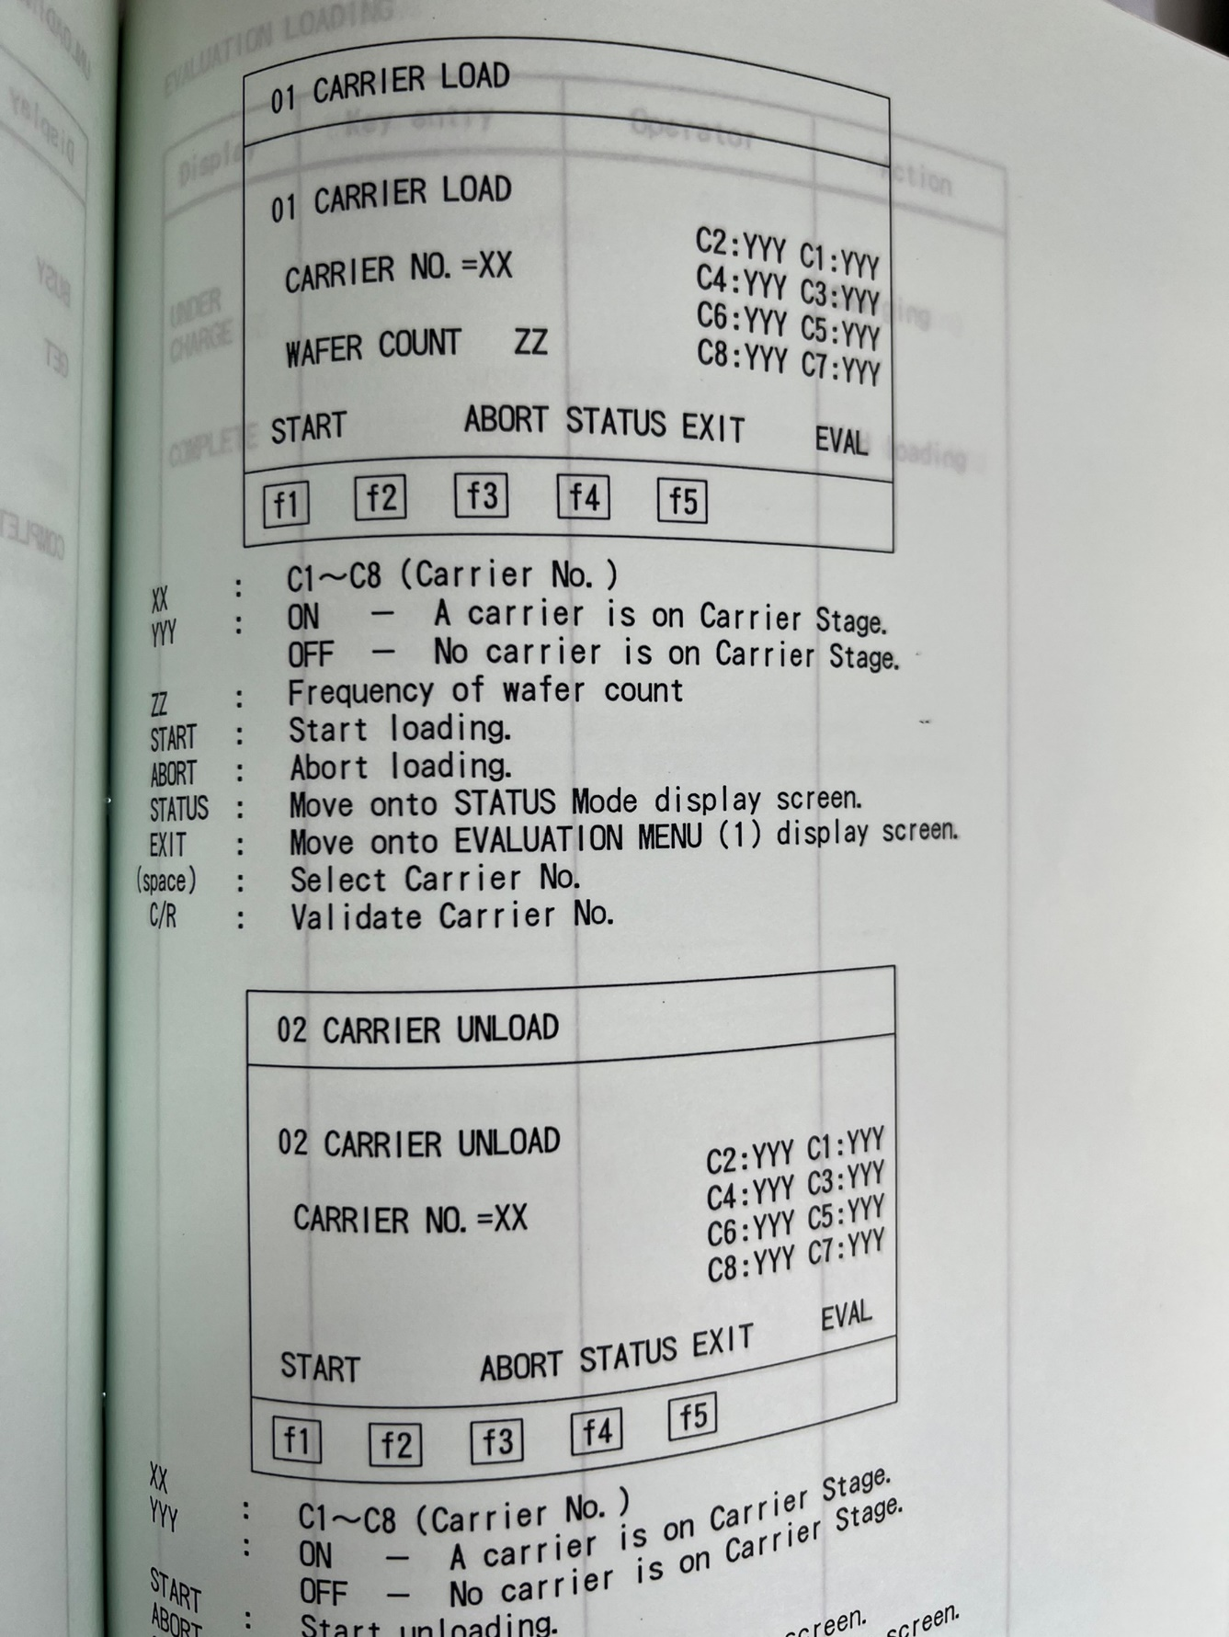
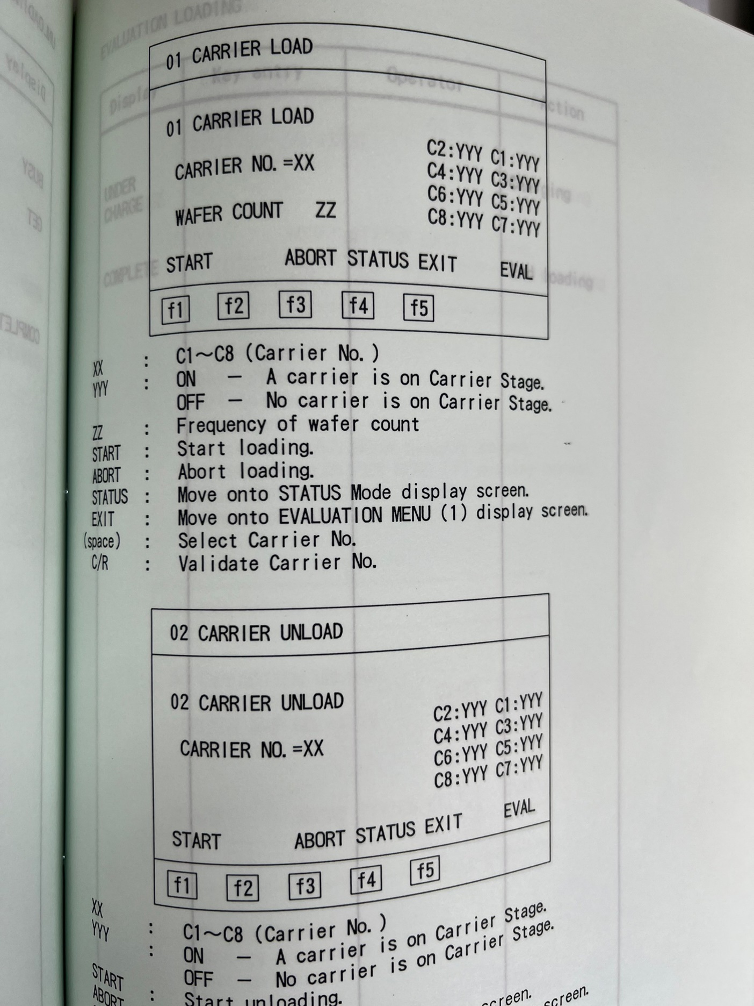
1.Carrier Load
選定特定位置將cassette 到該位置 Ex:C1~C6 & C8
2.Carrier Unload
將特定位置cassette unload
EVAL(Evaluation)

Slide 10
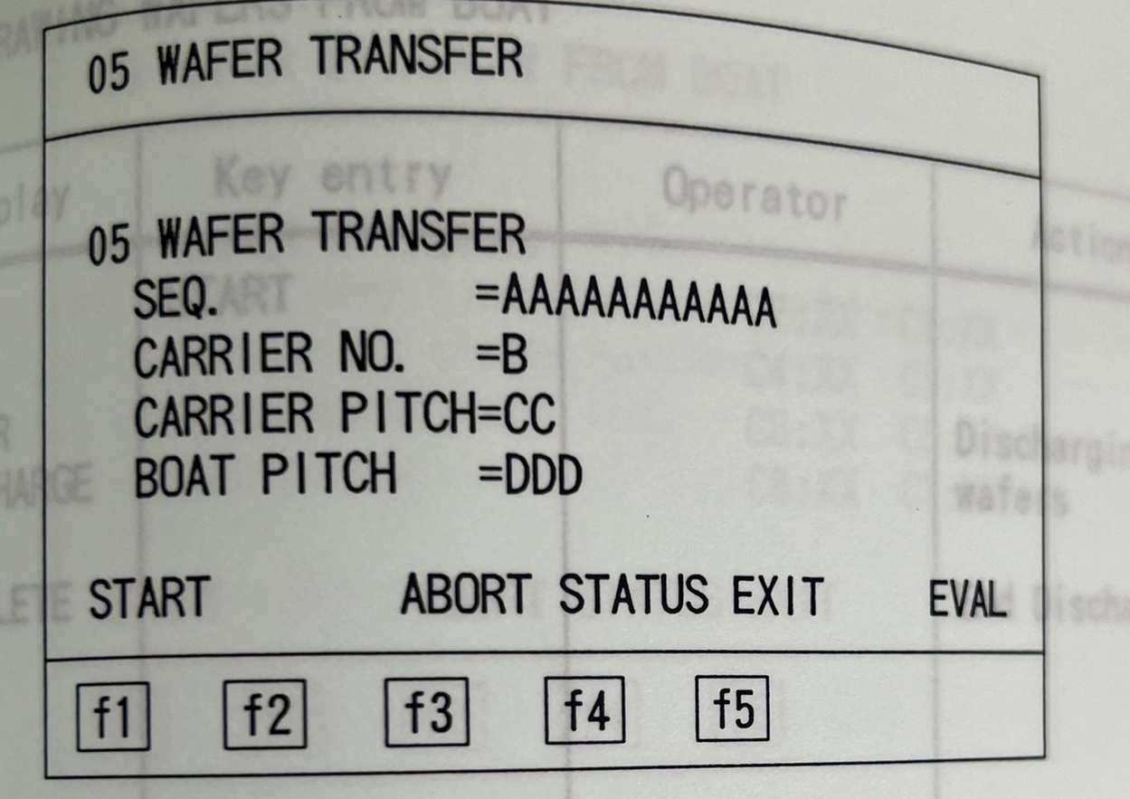
EVAL
3.Evaluation Load
選定MAP 後將cassette 執行load 及charge至boat
4.Evaluation Unload
執行MAP 將wafer 由boat discharge並unload
5.Wafer Transfer
選定特定carrier stage及carrier 位置作charge or discharge
6.Wafer Withdrawing from Boat
當機台發生問題無法正常discharge時使

Slide 11
1.Load
將產品load 並charge
2.UNLOAD
將產品discharge 並unload
3.MONITOR CARRIER SET
將控片load
4.MONITOR CARRIER RELEASE
將控片unload
5.DUMMY LOAD
將dummy load並charge至boat
6.DUMMY UNLOAD
將 boat 上dummy discharge並unload
7.EXTRA DUMMY LOAD
將extra dummy load 到carrier stage
8.EXTRA DUMMY UNLOAD
將extra dummy unload 到 I/O port
9.DUMMY EXCHANGE
將boat 上dummy discharge 並unload,
並將另外的dummy load 並charge
RUN

Slide 12
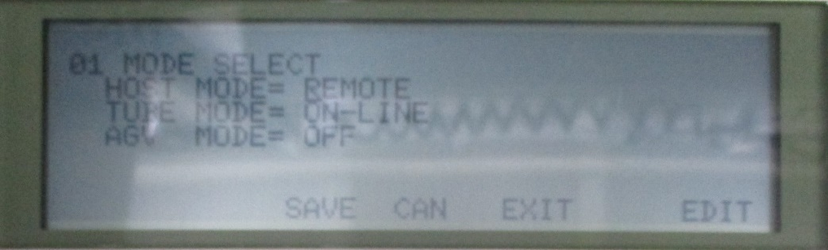
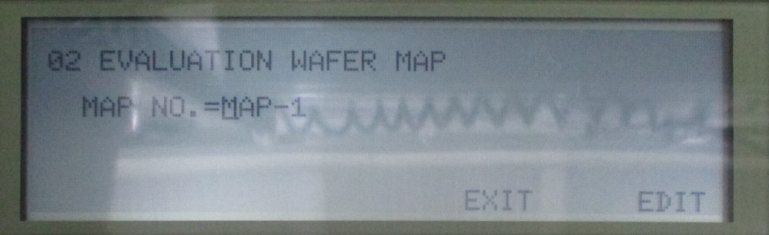
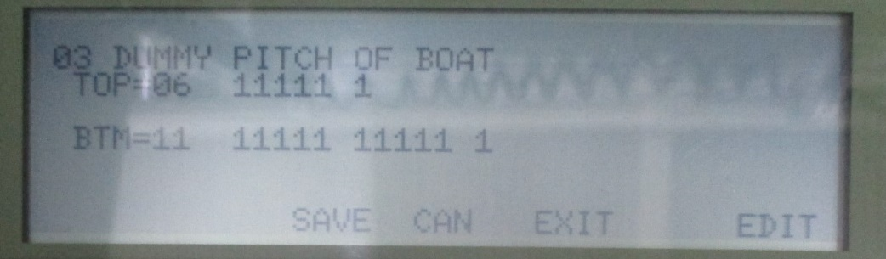
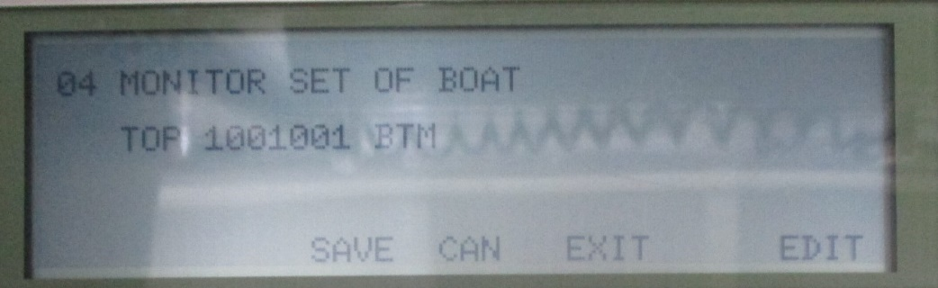
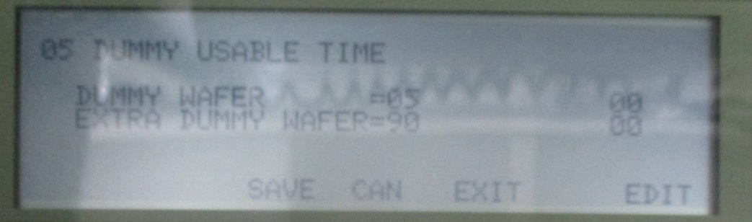
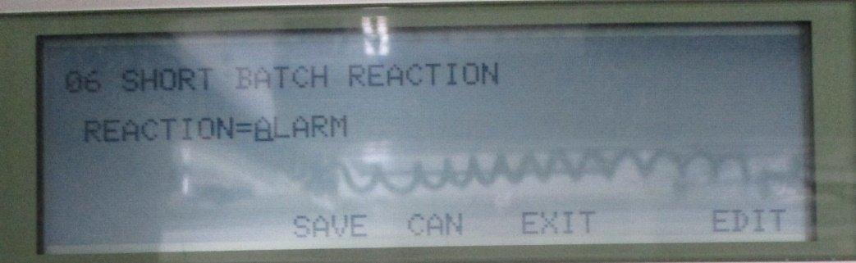
EDIT
1.Mode Select
2.Evaluation Wafer Map
在EVAL mode中,使用MAP作load or unload
3.Dummy Pitch of Boat
設定boat上dummy 位置及數量
4.Monitor Set of Boat
設定boat上monitor 位置
5.Dummy Usable Times
dummy 使用次數
6.Short Batch Reaction

Slide 13
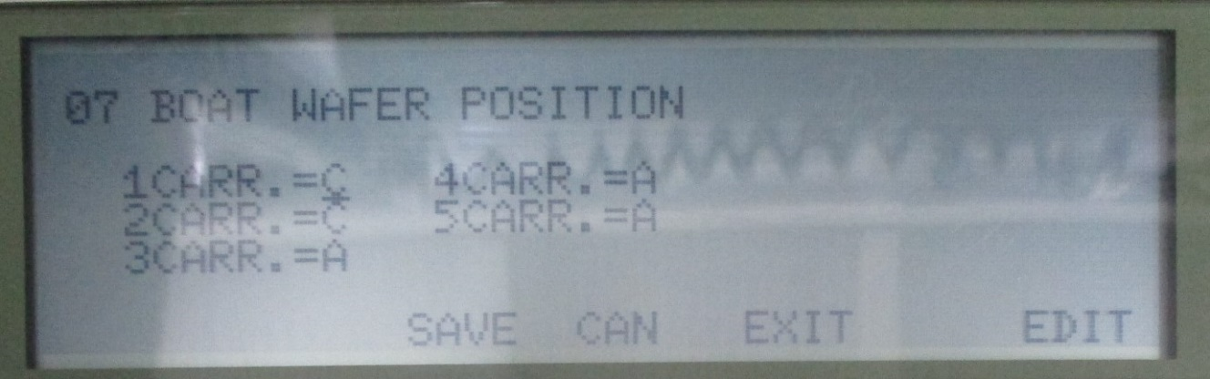
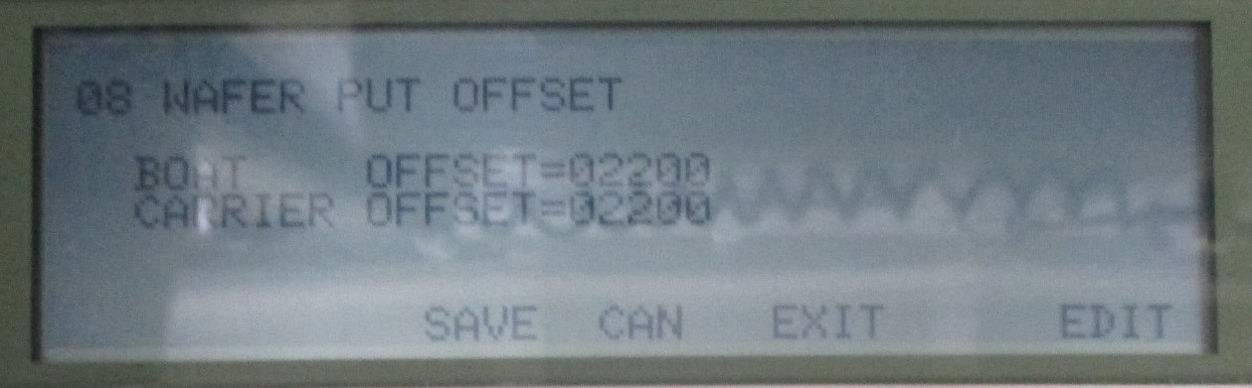
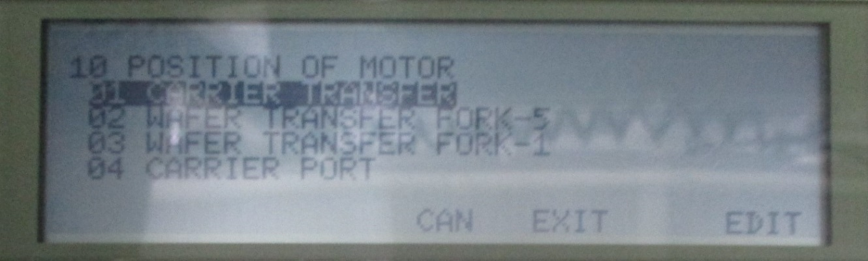
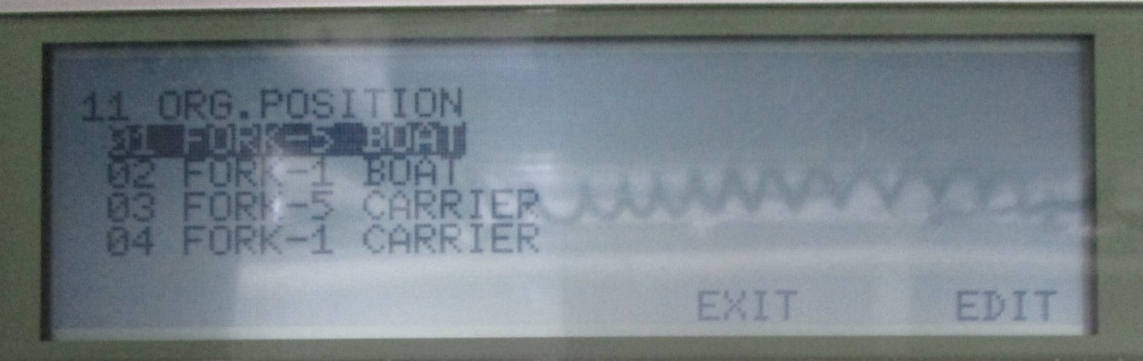
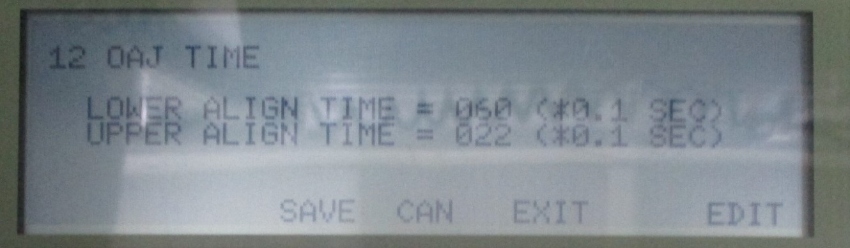
7.Boat Wafer Position
在產品未滿批時boat 傳送位置
8.Wafer Put Offset
設定傳送wafer時,垂直初始值
9.Speed of Motor
設定馬達速度
10.Position of Motor
設定馬達位置
11.Original Positions
調整 boat 上/下及carrier top 位置
12.OAJ Time
設定 轉平邊時間

Slide 14
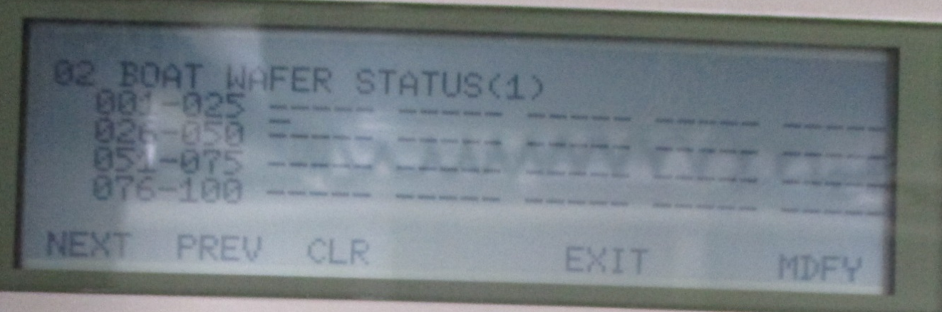
1.LOT ATTRIBUTE
未使用
2.BOAT WAFER STATUS
Wafer 在boat上之狀態
3.CARRIER STATUS
carrier 之狀態
MDFY

Slide 15
Thanks for your attention

